Slide 1
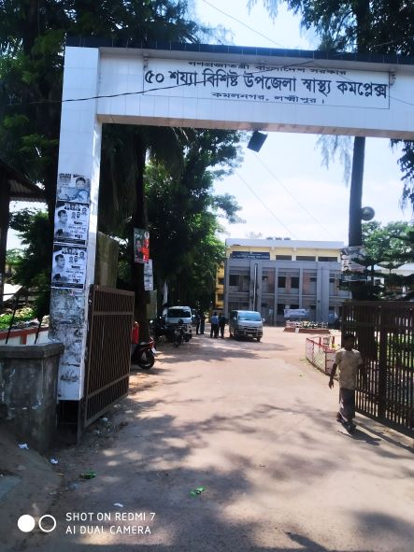
Kamalnagar UHC, Lakshmipur

Slide 2
A Hospital with a Vision …
Maximum utilization of Govt.
resources with
honesty and sincerity.
Integrated approach of
Administration, Community
Leaders .
Providing Effective services
through improved
management system.

Slide 3
Health Profile of Kamalnagar Upazila- 2022
Total Union: 09
Pourosova
Total Population: 2,63,545
Total Fertile Couple
Total Pregnant Mother
Total Under 5 Children
Health Man Power
Doctor : 13
Nurse: 15
Midwives:0
Medical Technologist: 3
HA: 33
Security Guard & Cleaner: 7
Health Institutions
Health Complex: 01
Sub-Centre:2,
FWC: 4
Community Clinic: 22
Non- Govt Clinic: -

Slide 4
Mother Taken-ANC 1st :
Hospital Delivery Rate :
No. of Hospital bed : 50
Bed Occupancy Rate :
EPI Coverage :
Covid-19 ( Immunization Coverage ):
CPR :
TFR :
CBR :
CDR :
Population Growth Rate :
Maternal Mortality Ratio :
Neonatal Mortality Rate :
Infant Mortality Rate :
Under-5 Mortality Rate :

Slide 5
Background History of Kamalnagar UHC
*Kamalnagar UHC started as 31 bedded Hospital in 1981
*The Health complex upgraded to 50 bedded in.
* From 2012 UH&FPO started 3 special activates
<4 Special activities>
ANC-Corner
Basic EOC service
Under 5 corner for under 5 children
#

Slide 6
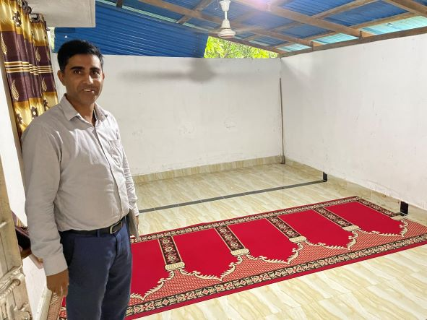
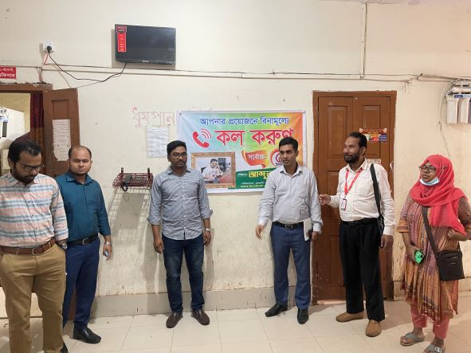
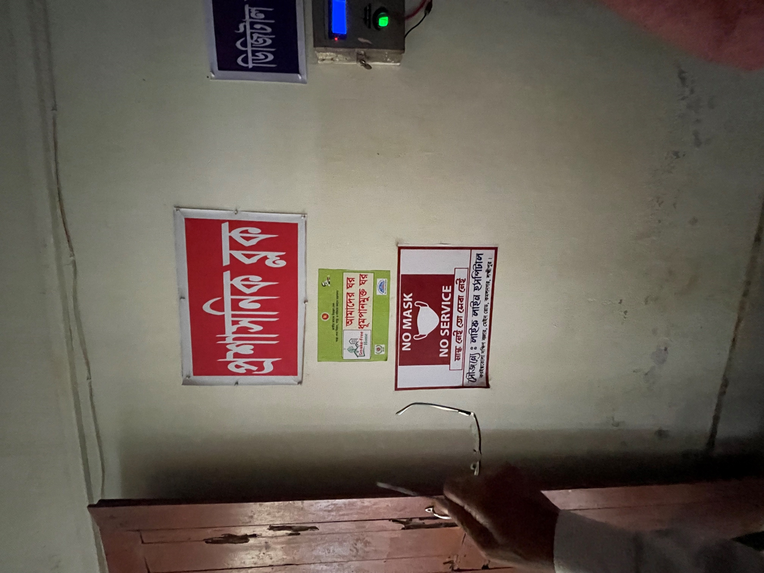
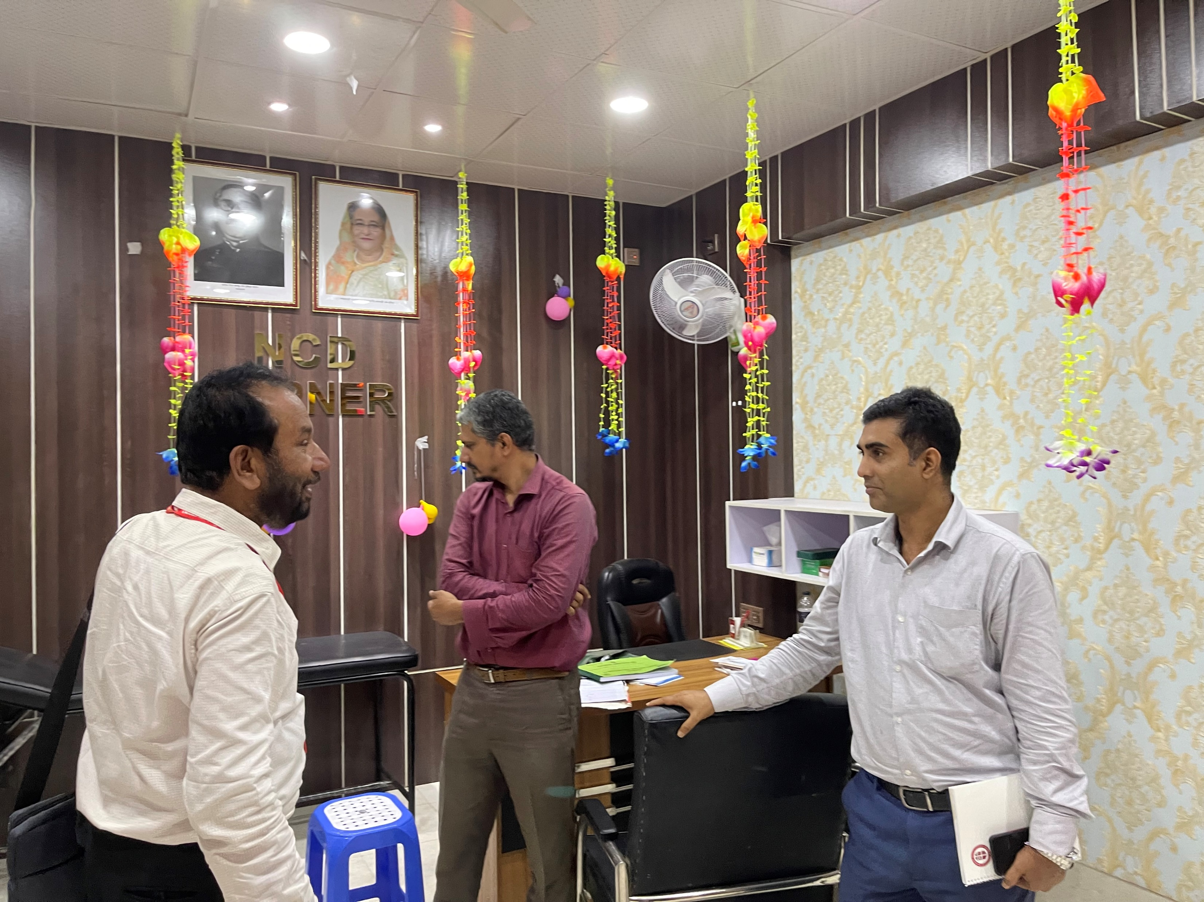
New Innovation
Female Prayer Room
Phone Booth free of cost
Air mark for Administrative Block
NCD Corner

Slide 7
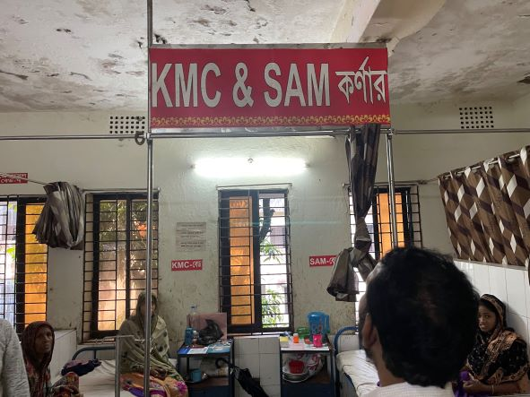
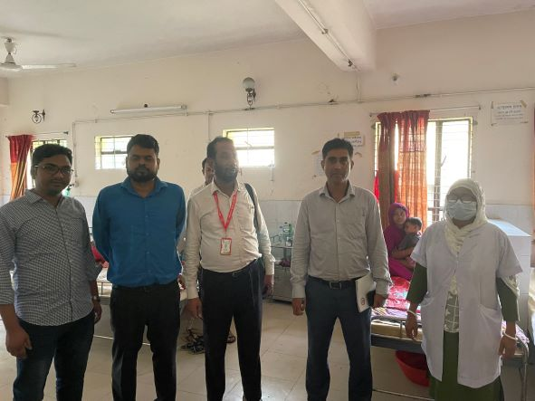
KMC & SAM Corner & Paediatrics Ward

Slide 8
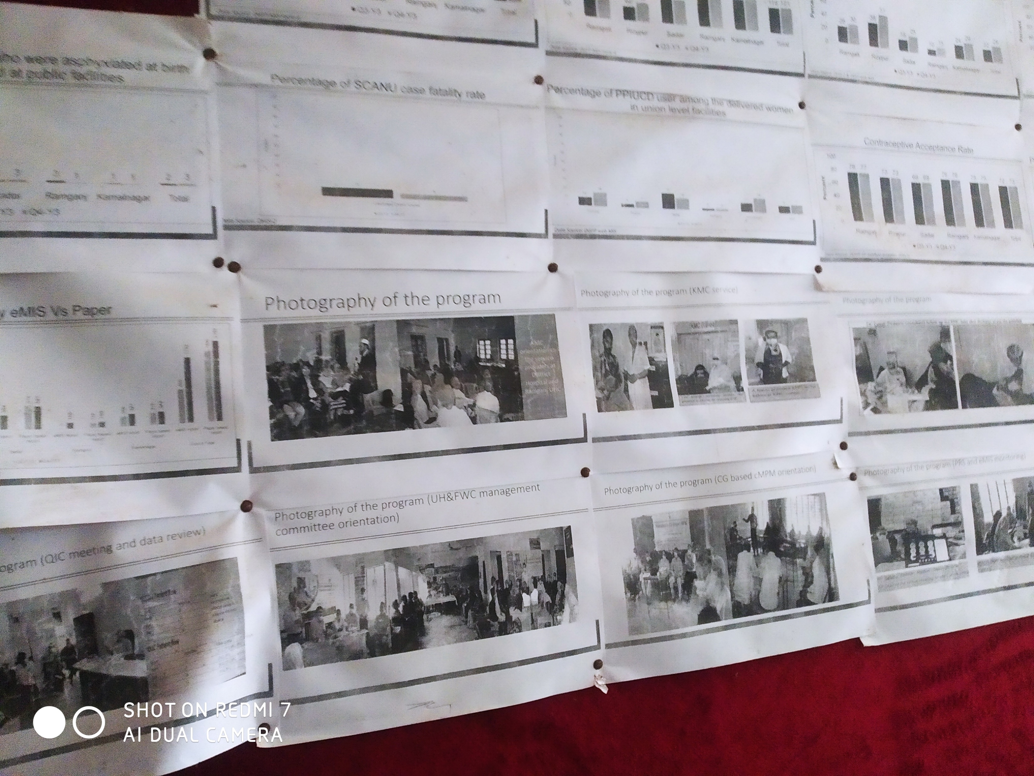
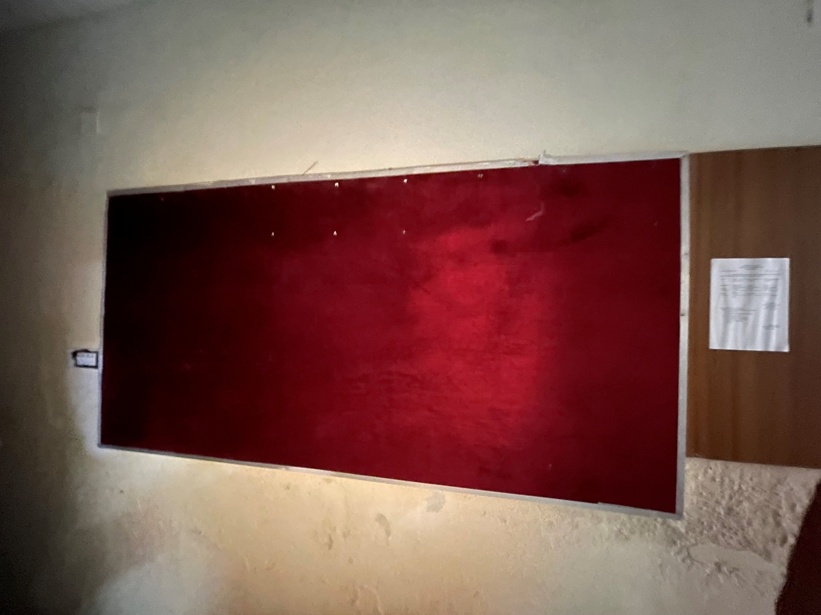
Changes in the Display Board
BEFORE
AFTER

Slide 9
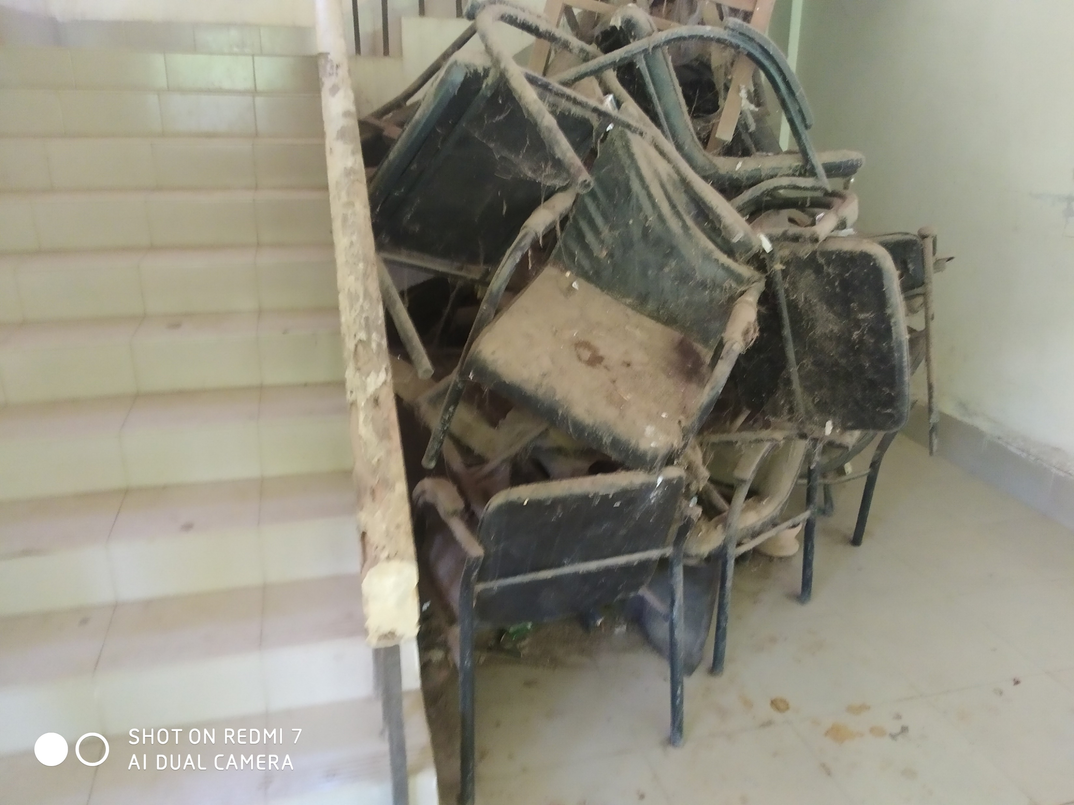
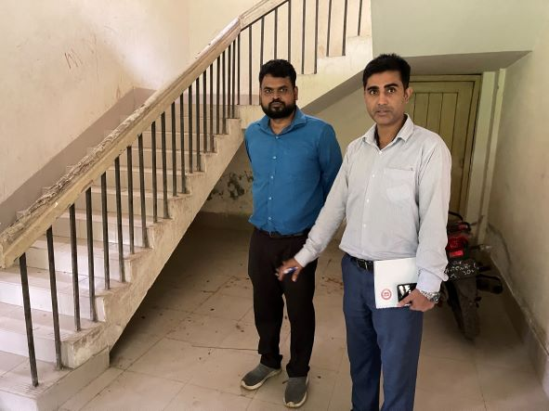
Removal of unwanted items
BEFORE
AFTER

Slide 10
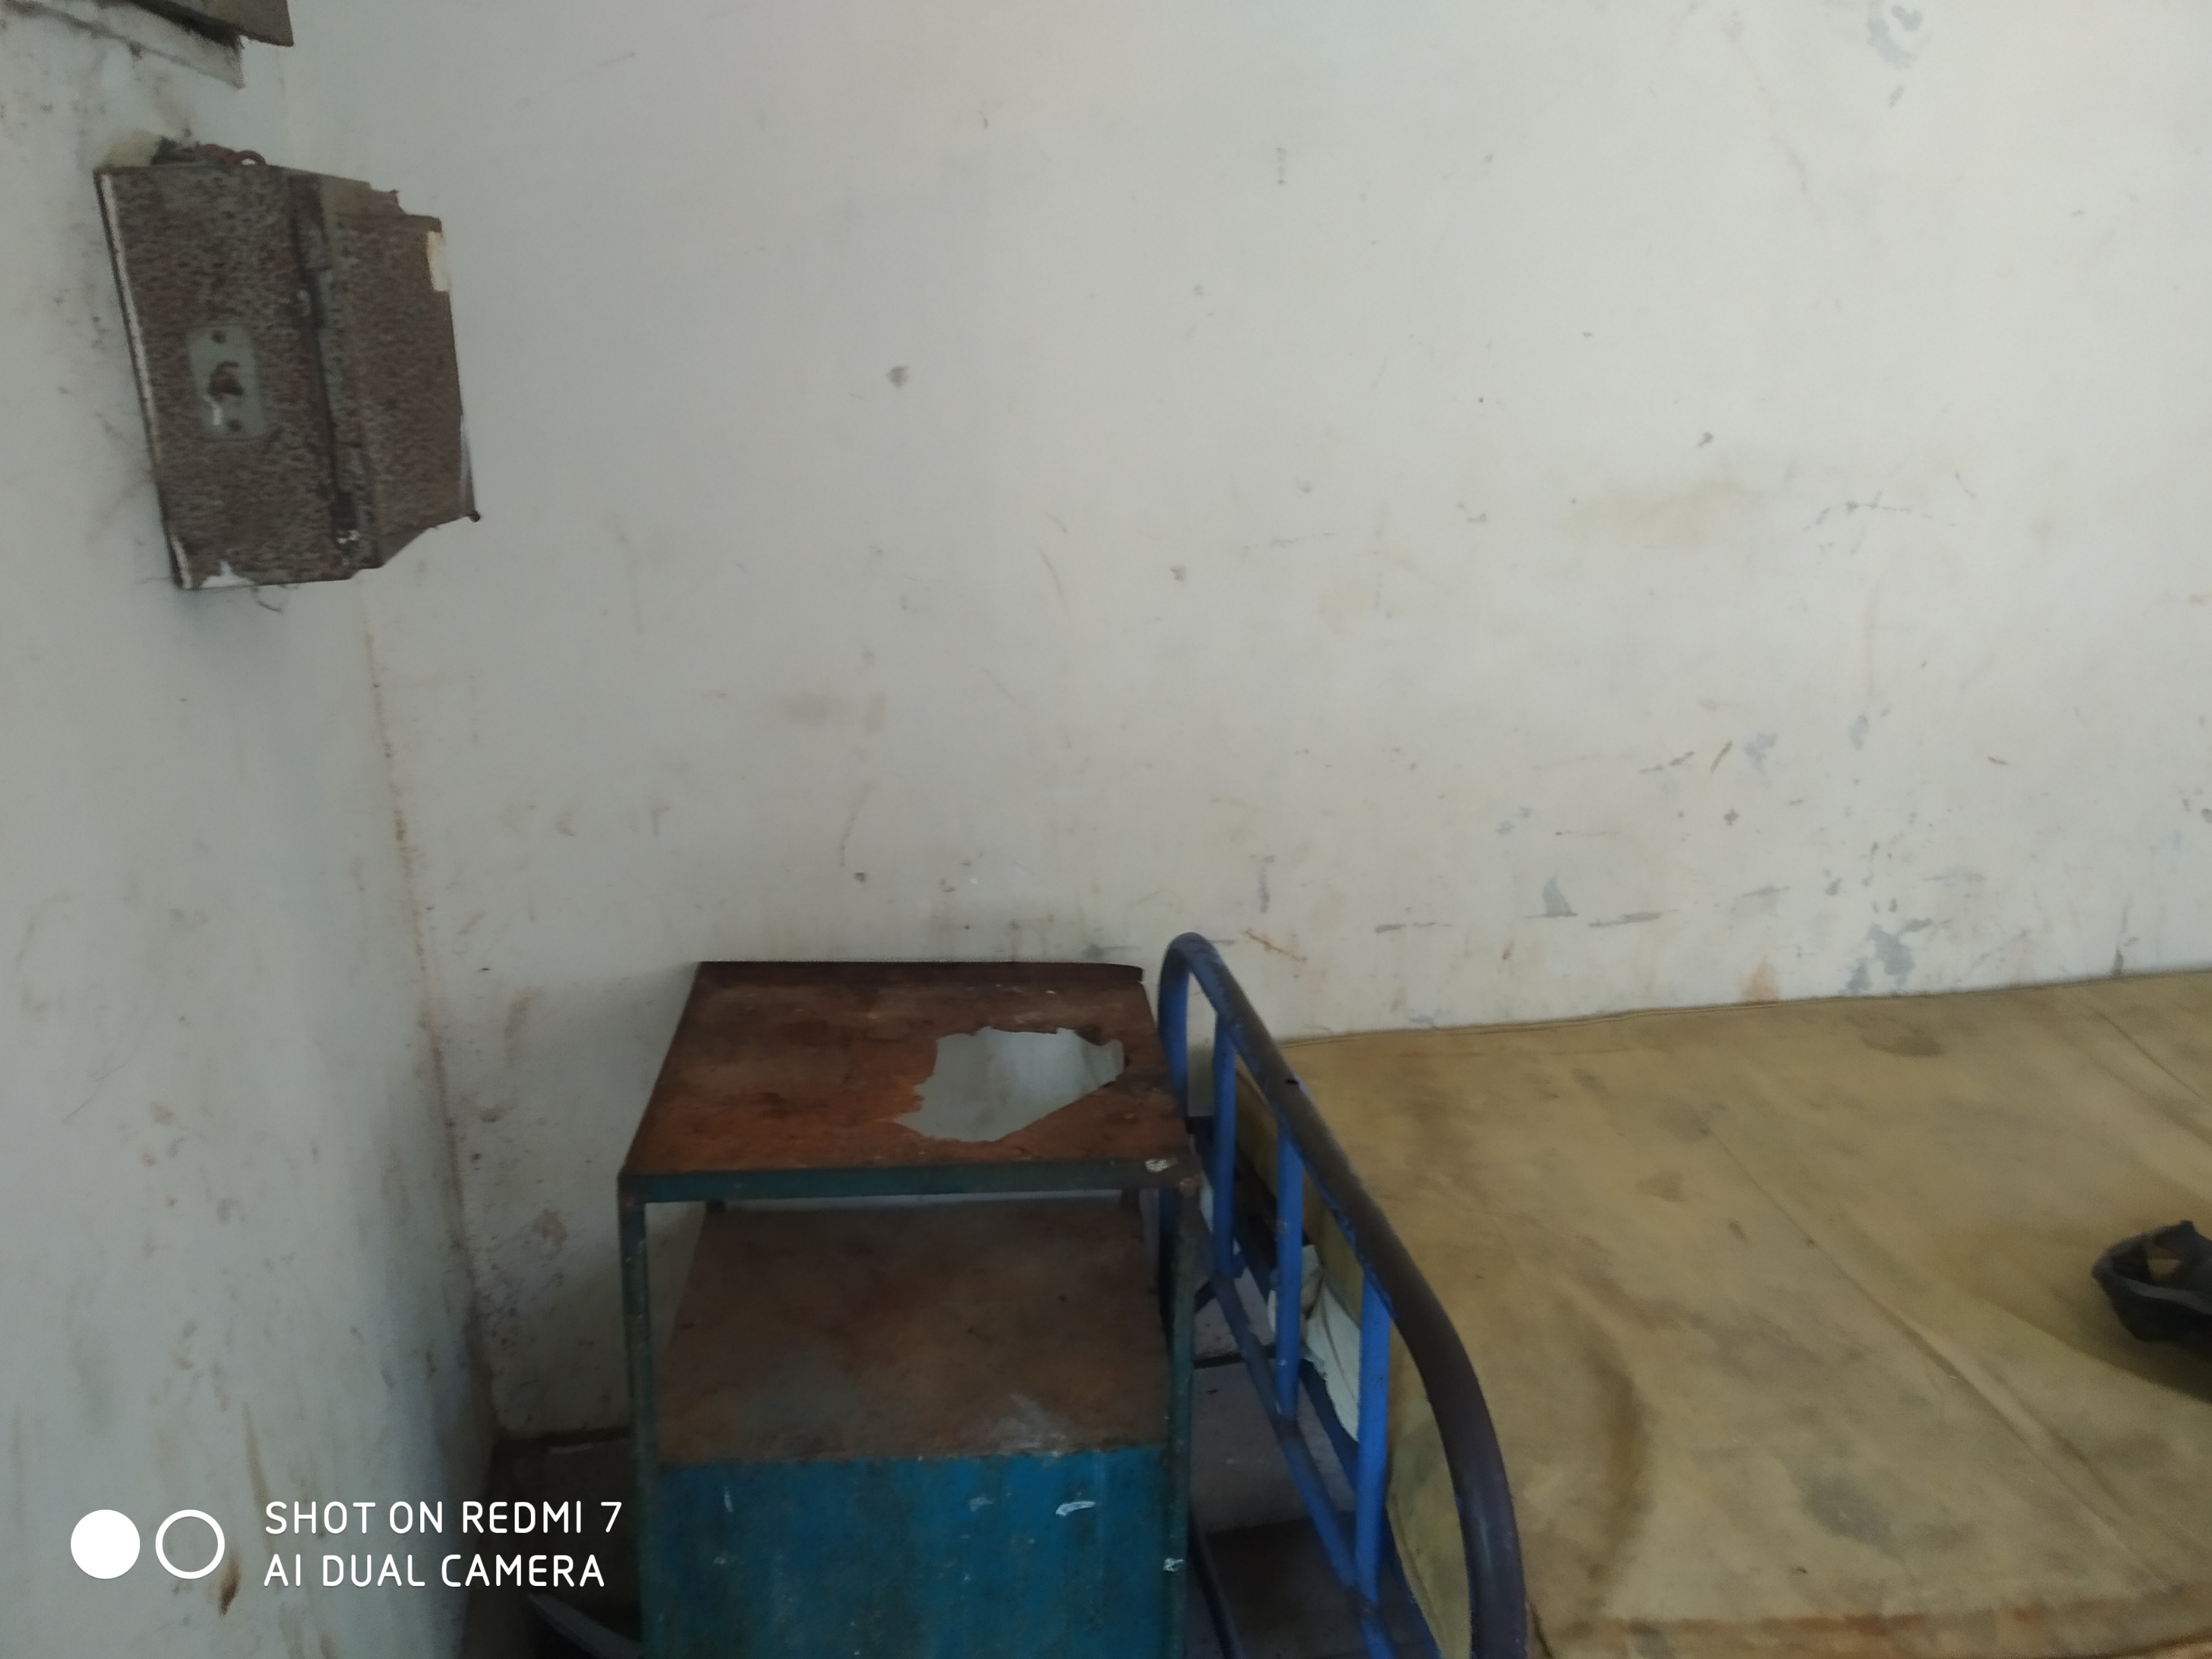
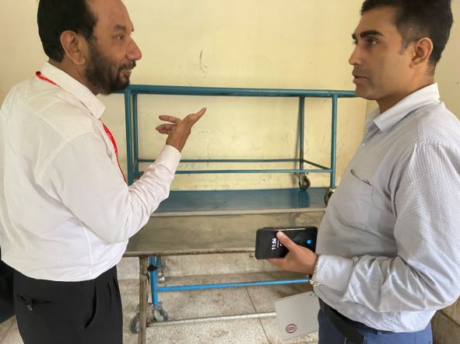
Removal of unwanted items
BEFORE
AFTER

Slide 11
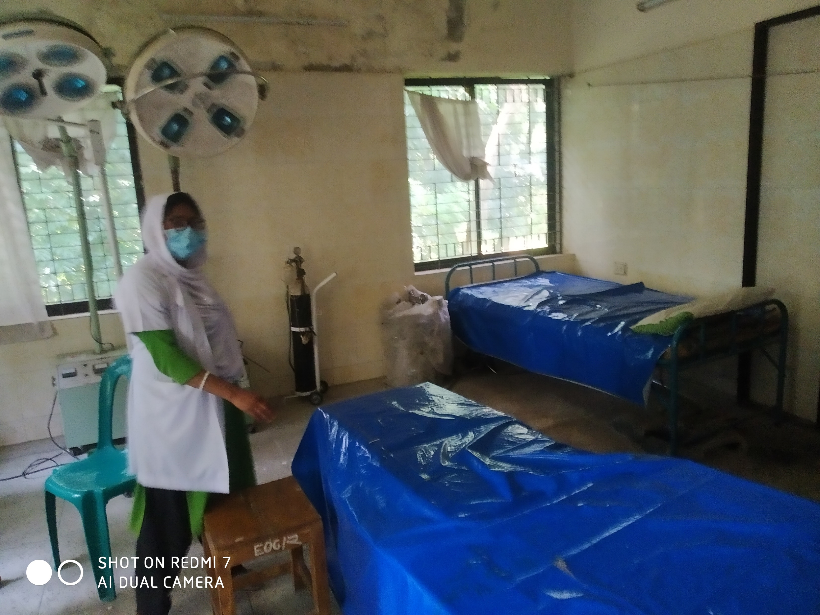
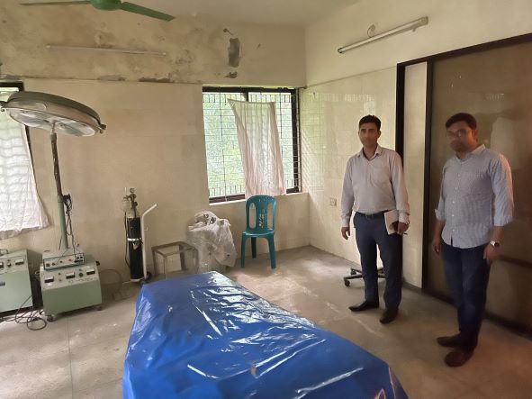
Removal of unwanted items from OT
BEFORE
AFTER

Slide 12
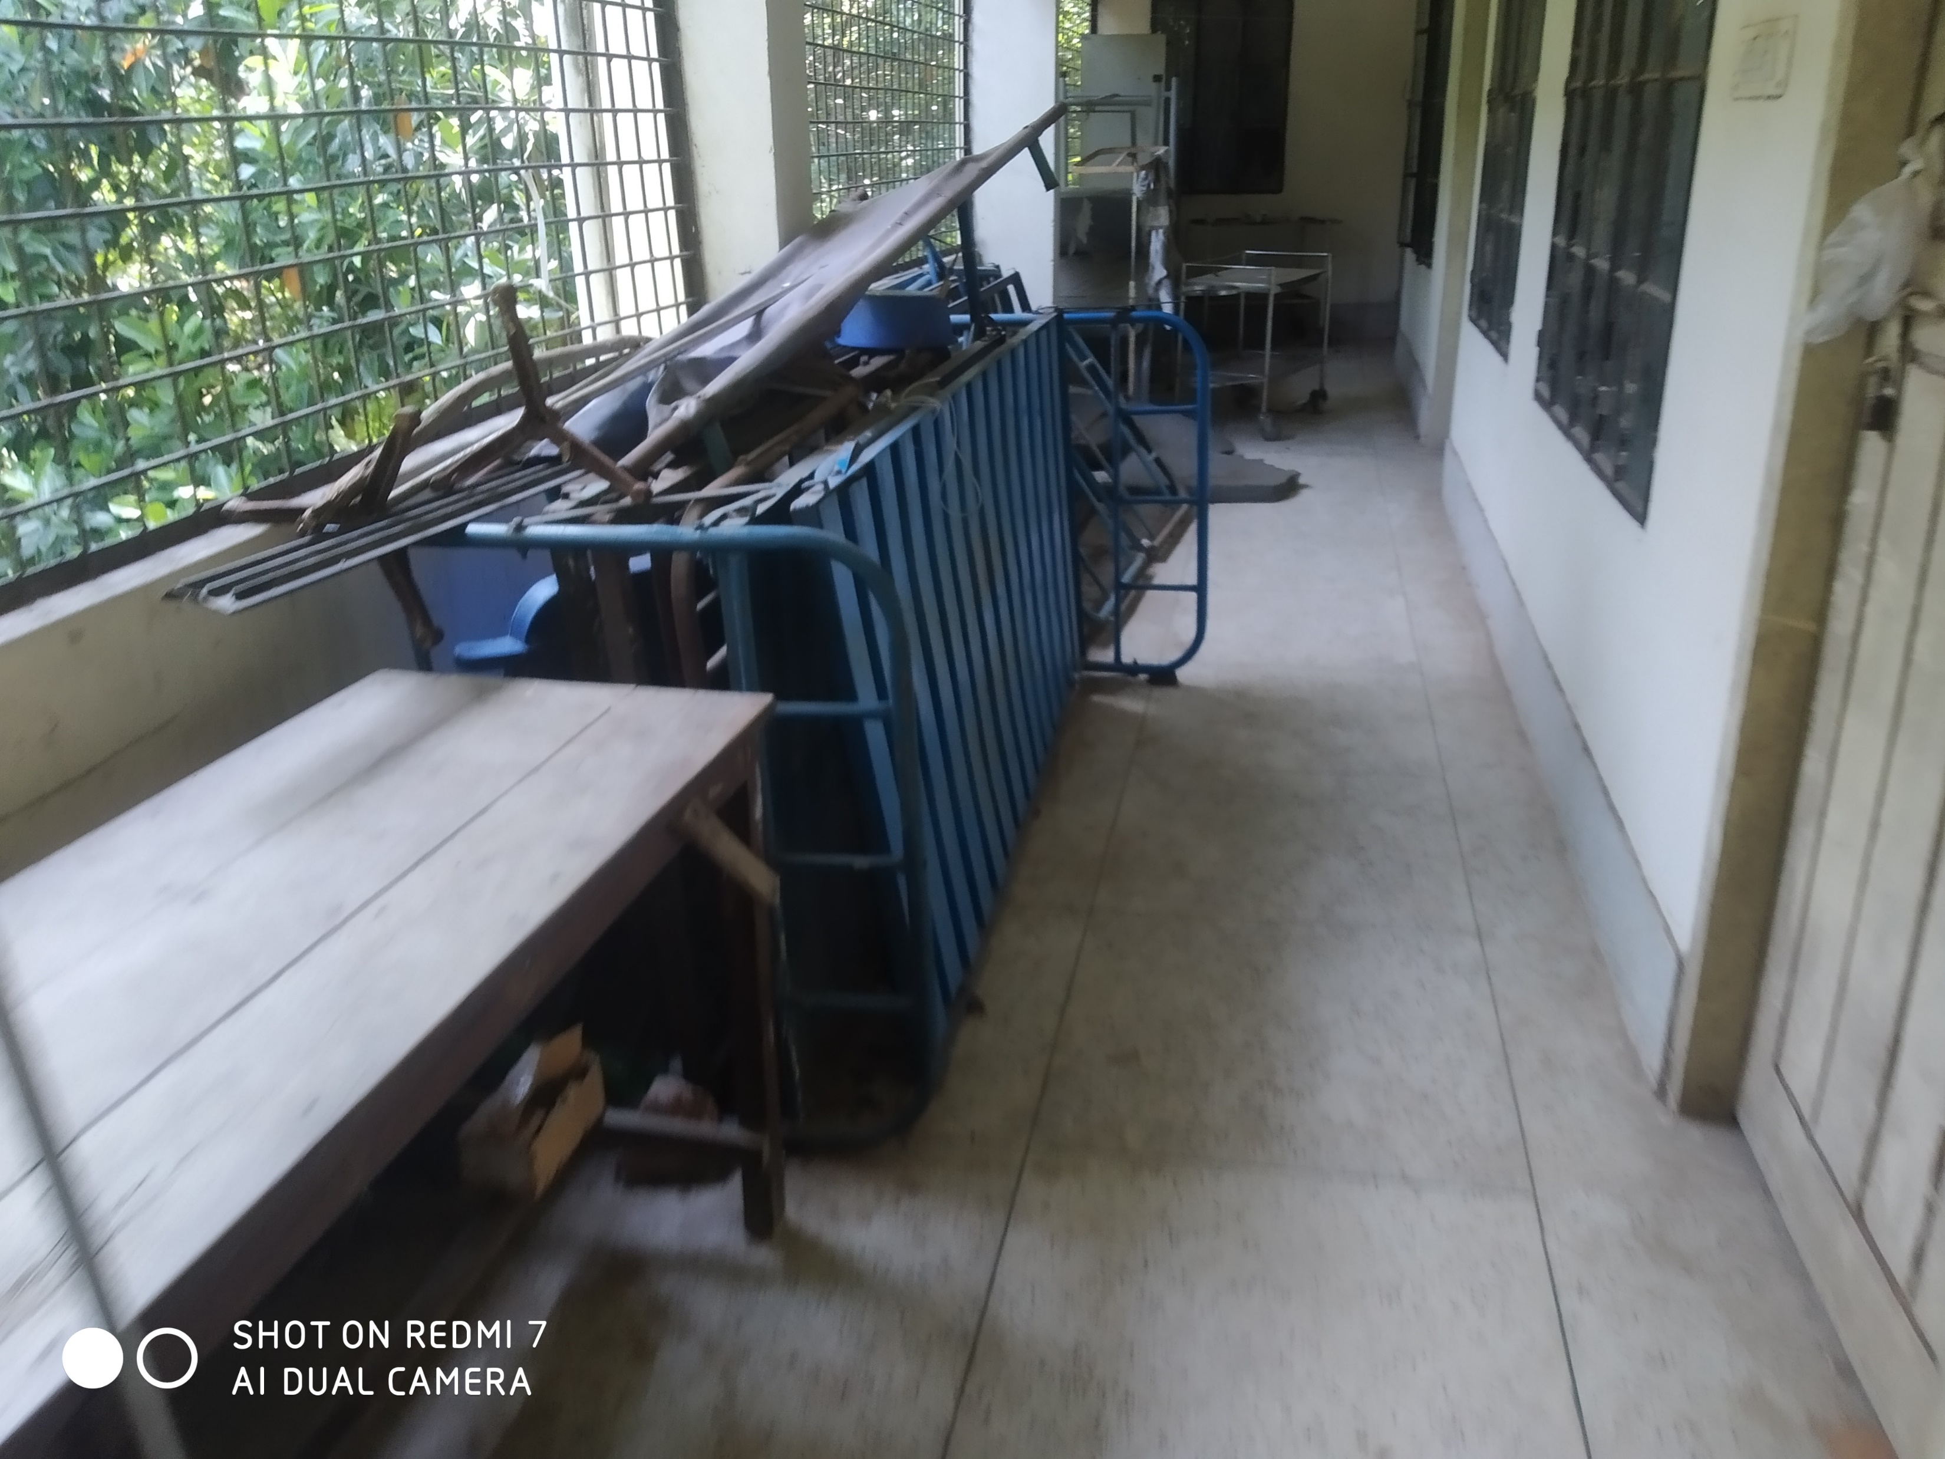
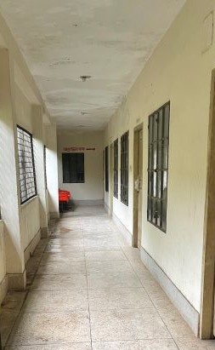
Removal of unwanted items from OT
BEFORE
AFTER

Slide 13
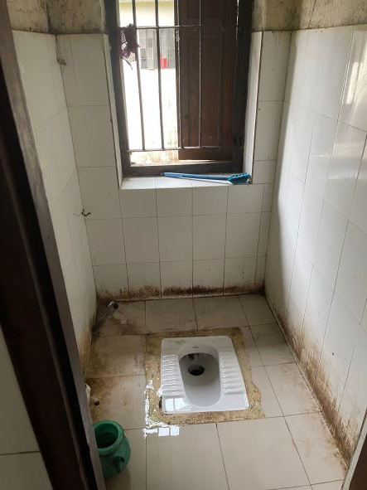
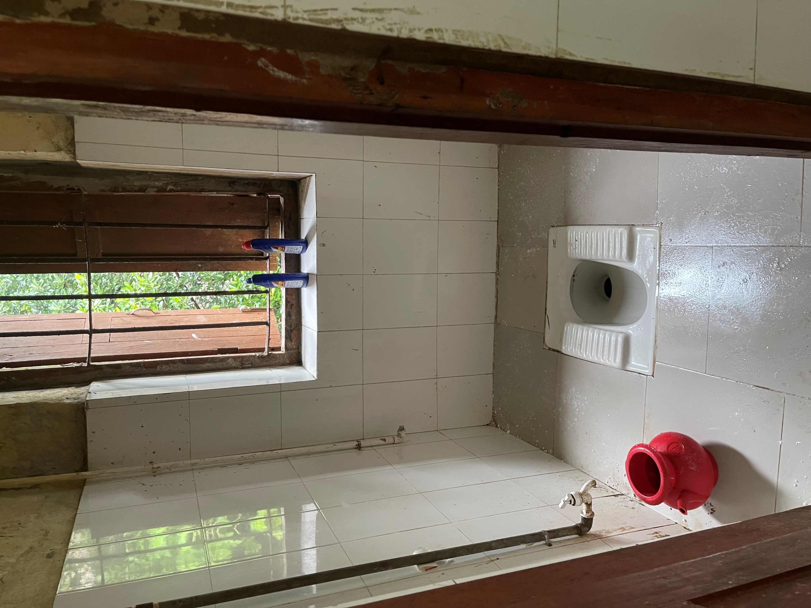
Cleanliness of Toilet
BEFORE
AFTER

Slide 14
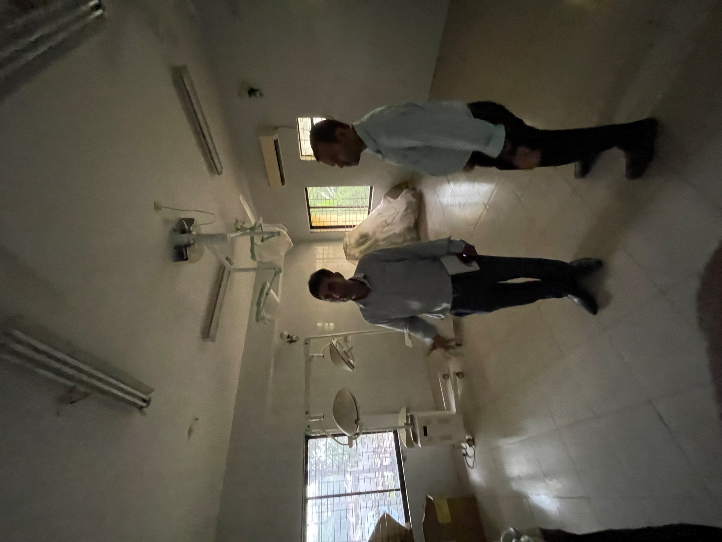
Preparation of OT by removing all unwanted Items

Slide 15
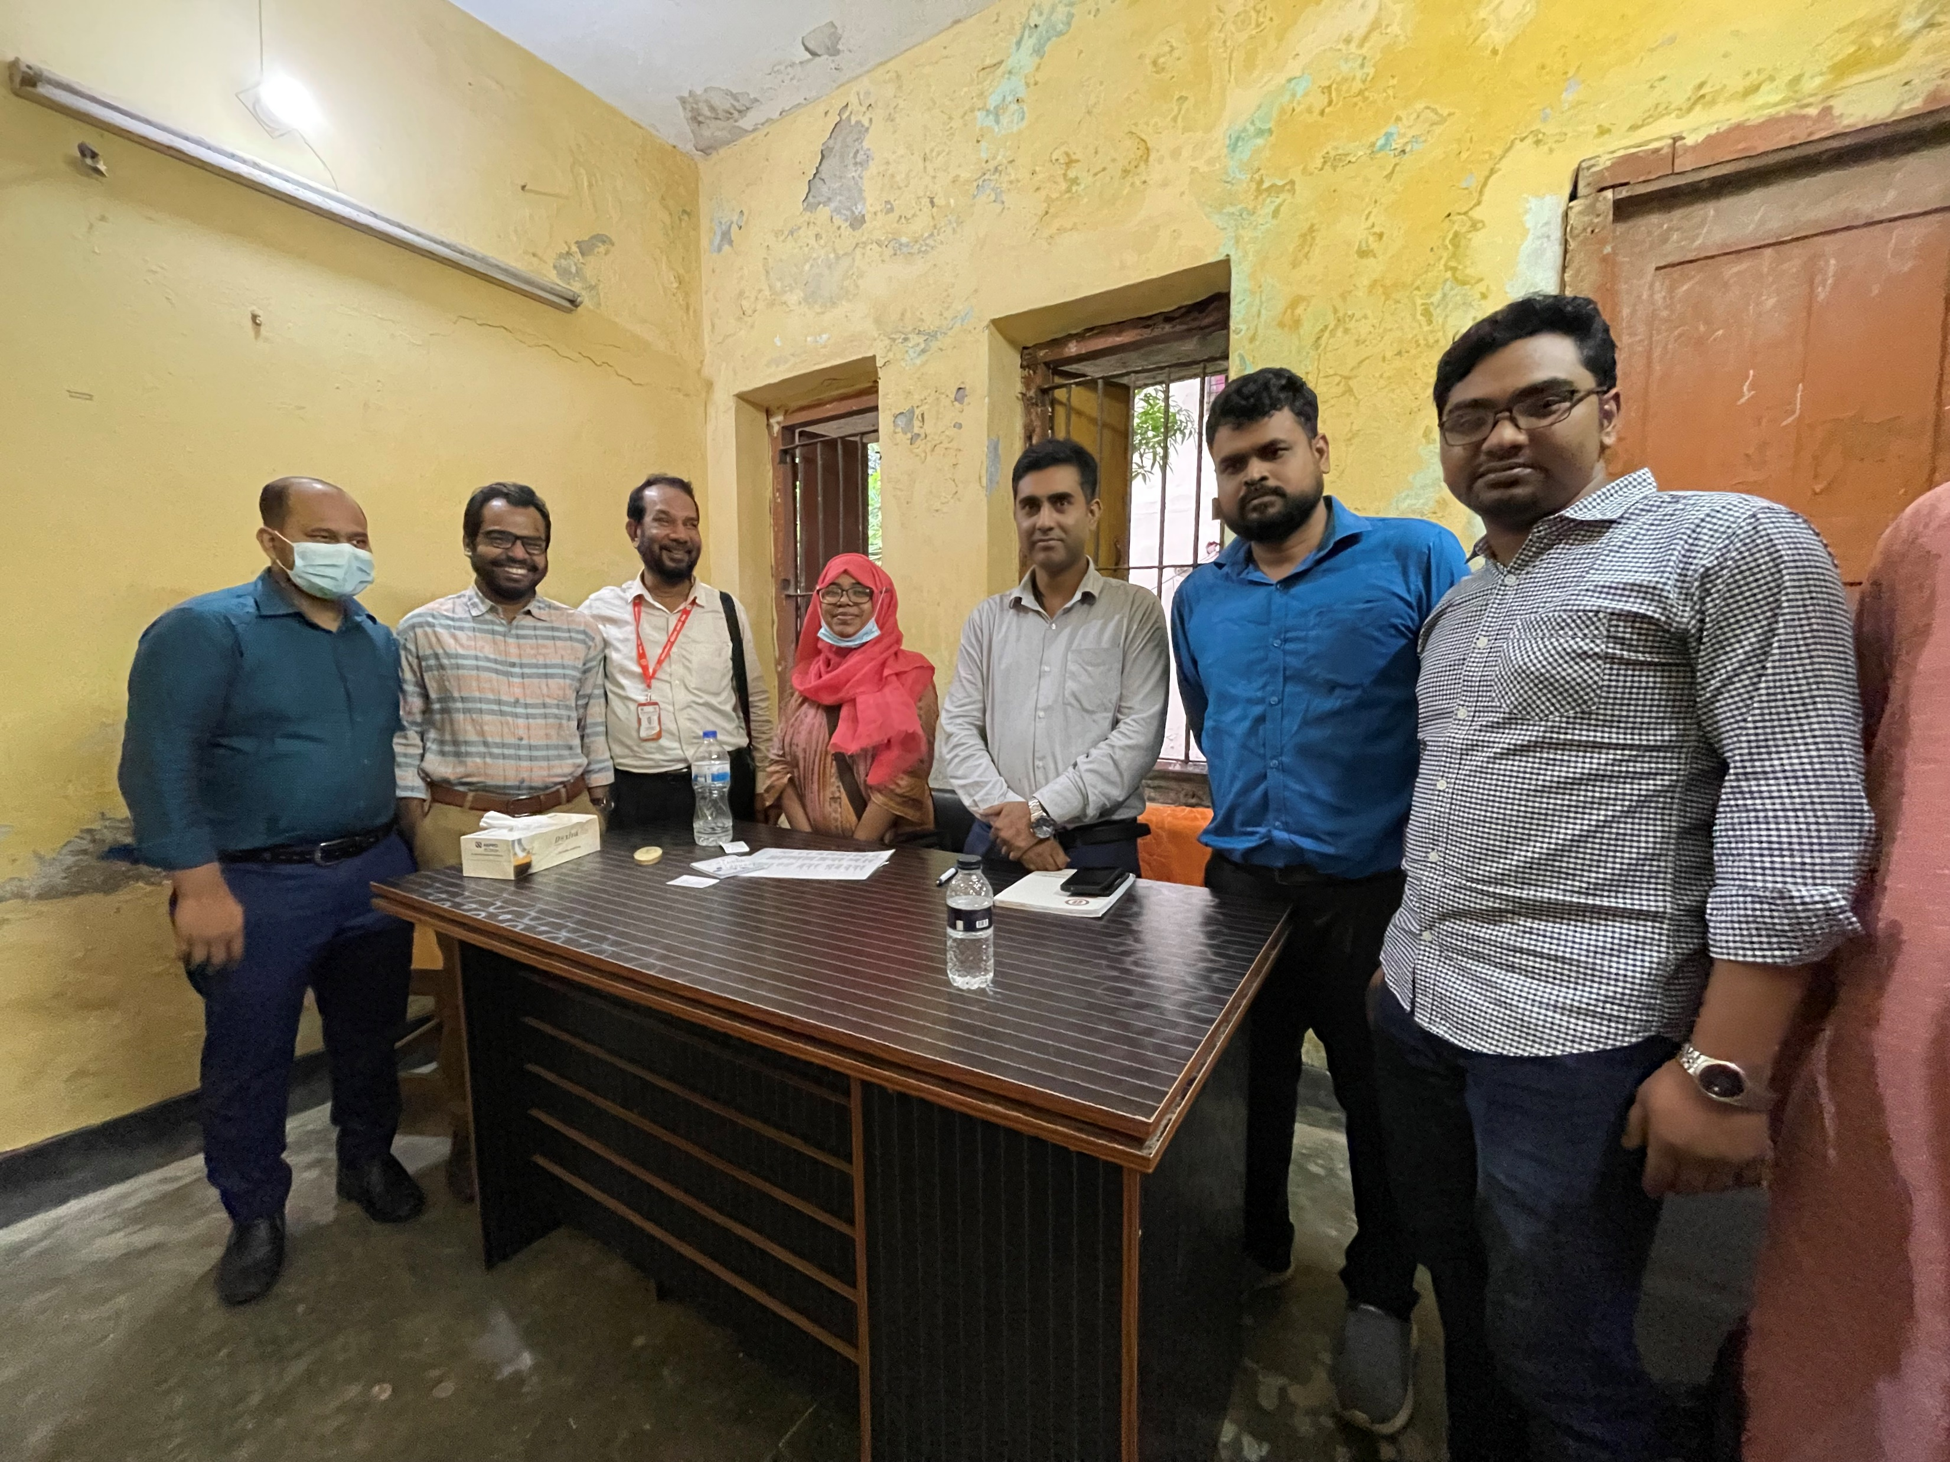
New desk funded by Medical Officer

Slide 16
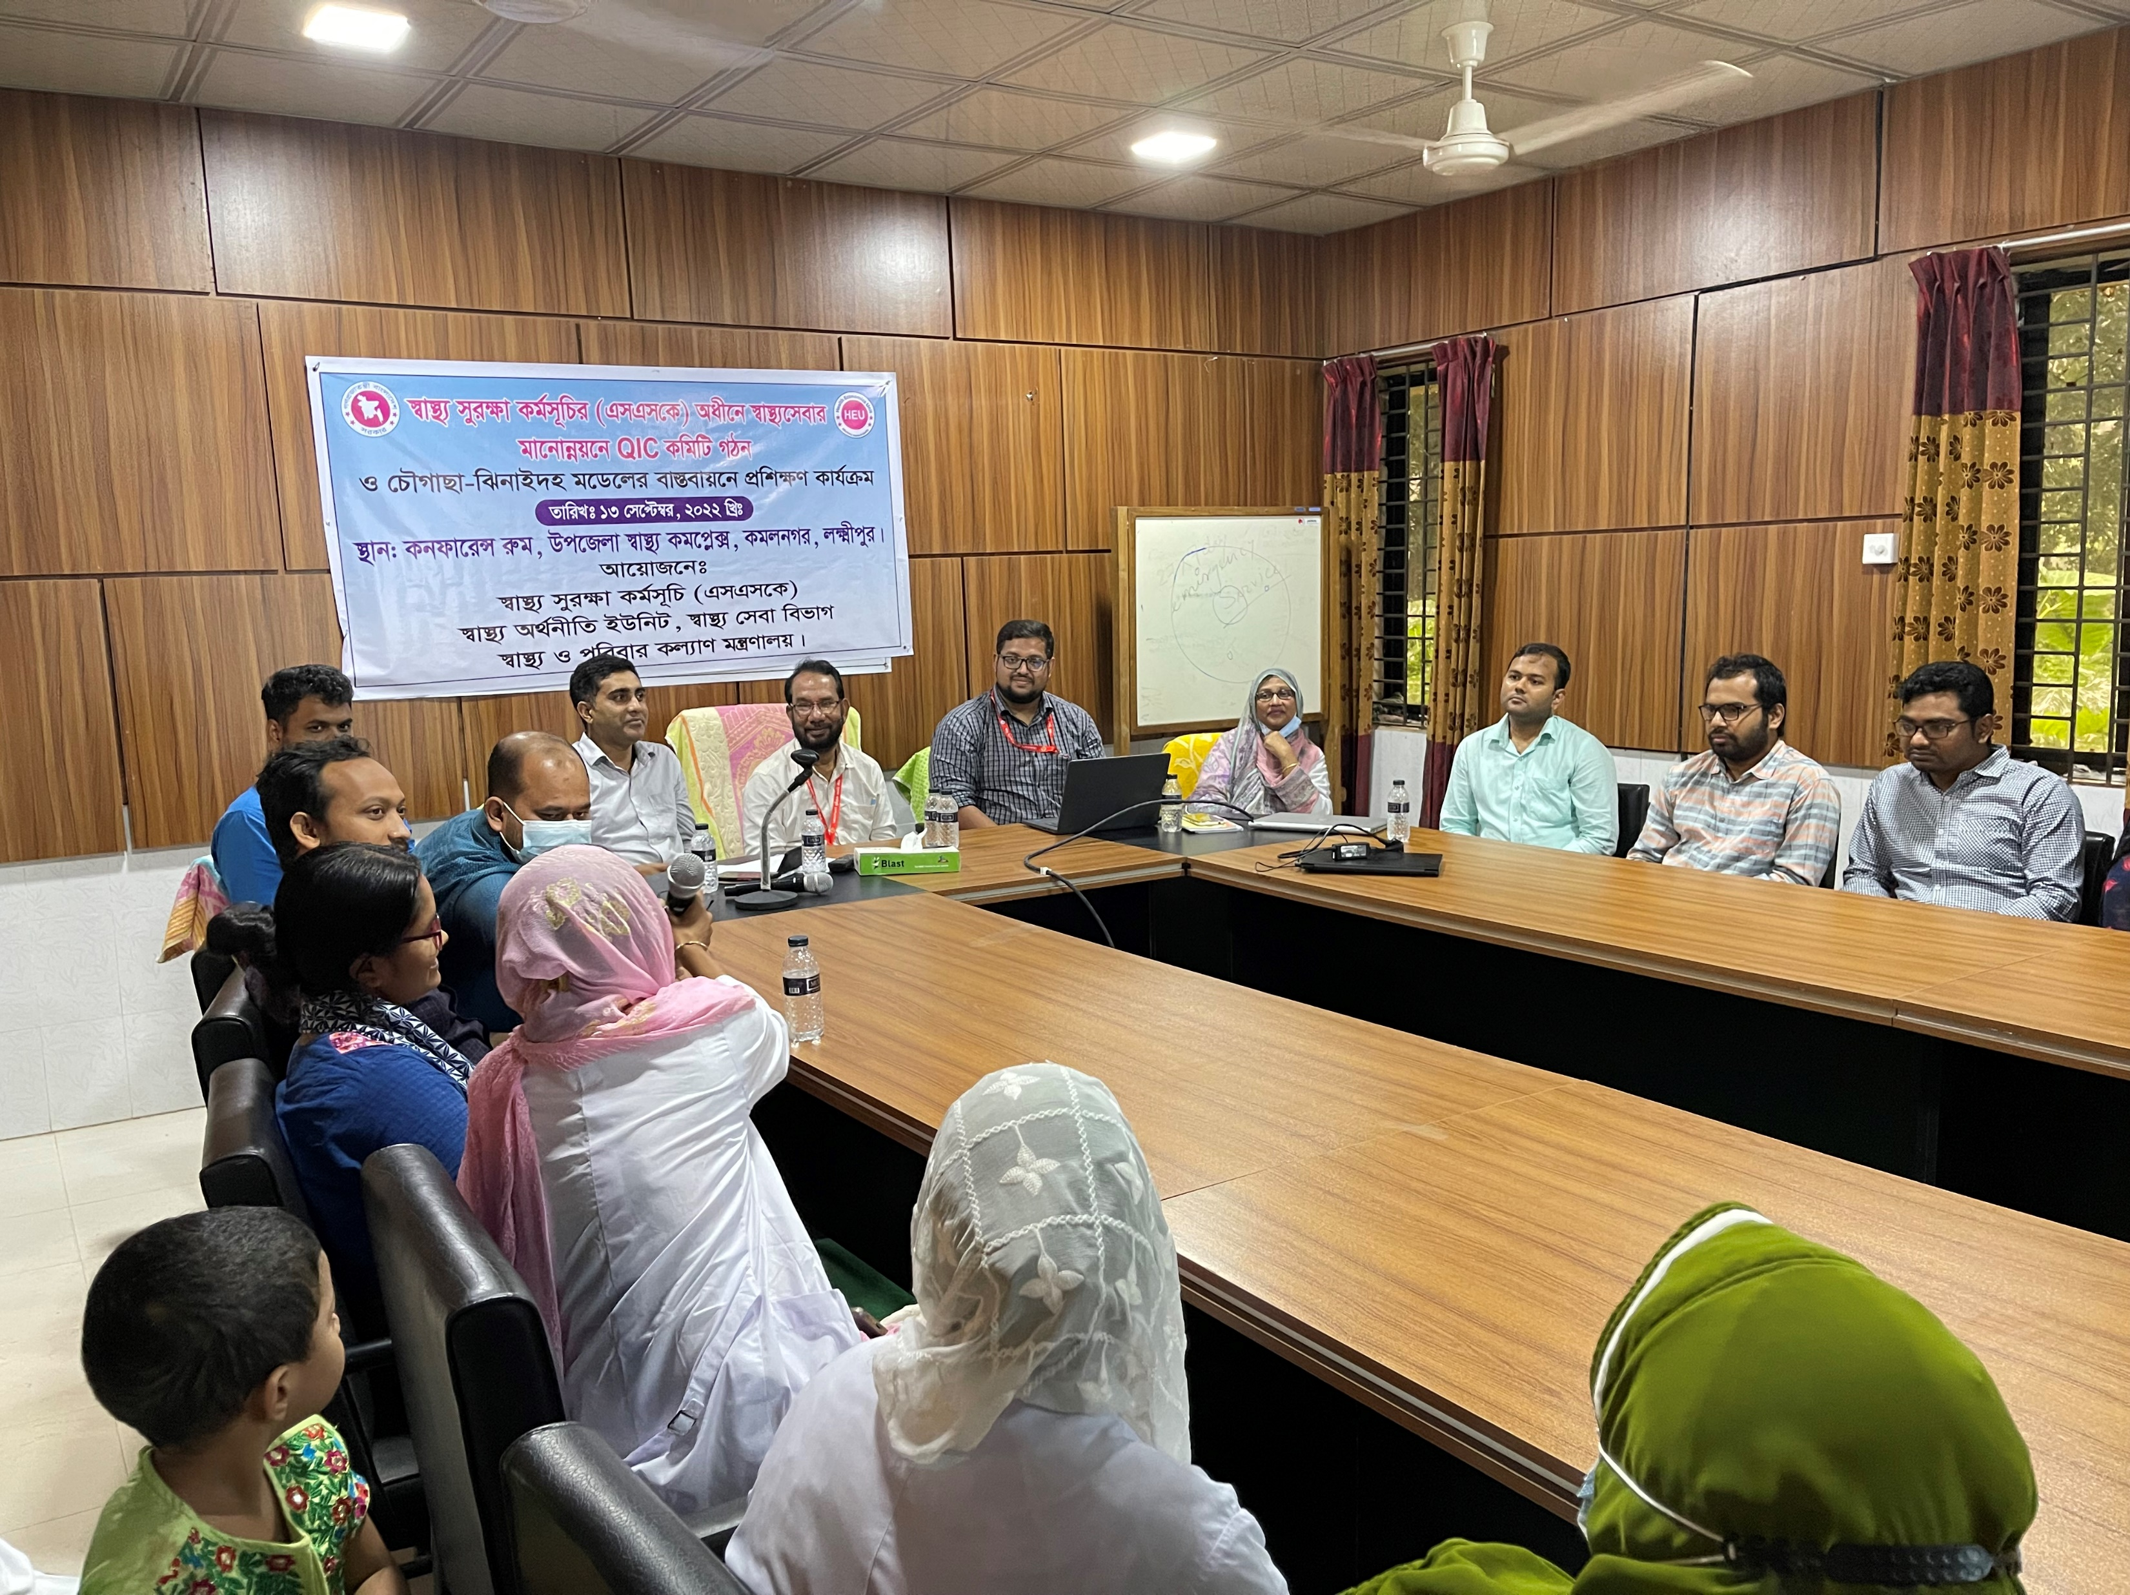
Training on Quality of Care and formation of QIC committee

Slide 17
Challenges of the Health Complex

Slide 18
Way Forward….

Slide 19
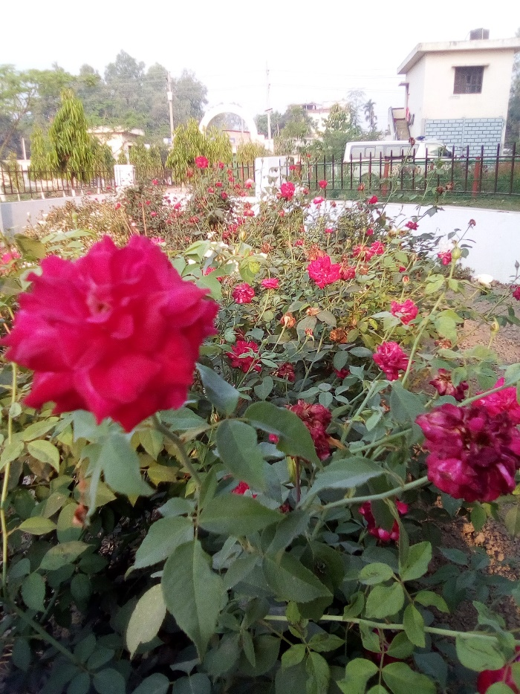
Thanks You

